Slide 1
Minimization of DFA

Slide 2
Algorithm
Step1: identify the not reachable states and eliminate it
Step 2: Group the set of states as accepting and non accepting states
Find out the equivalent set of states based on transitions and inputs.
For example :
Then consider p and q are ‘a’ equivalent. Check this for all the inputs with respect to the current group
Continue to find the equivalent set of states till possible
Construct the minimum DFA

Slide 3
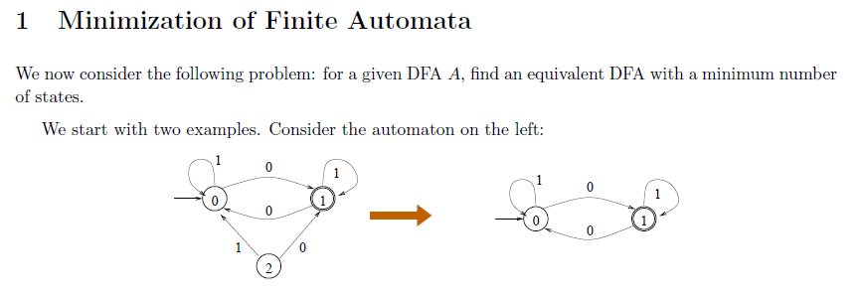
Example

Slide 4
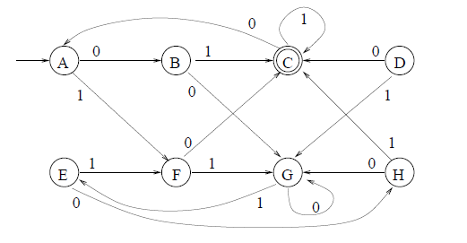
Minimize the following DFA

Slide 5
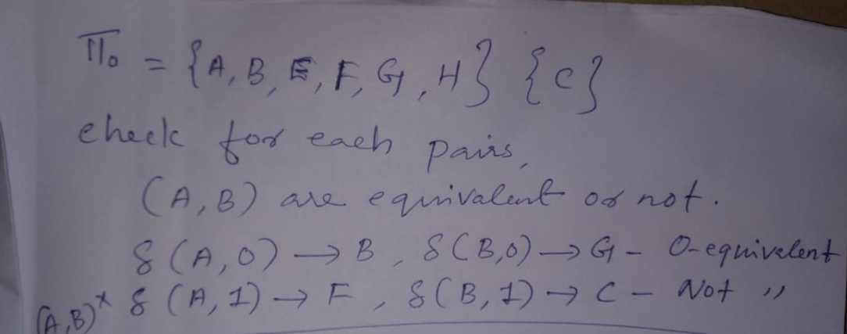
Step1. Find out the not reachable states
--Eliminate D

Slide 6
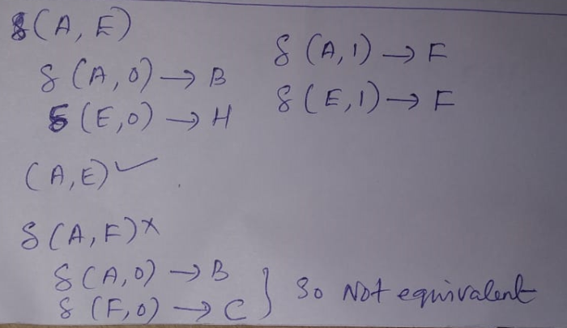

Slide 7
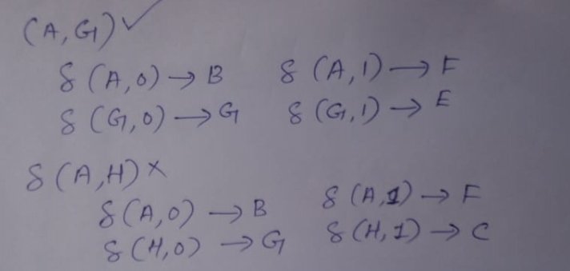

Slide 8
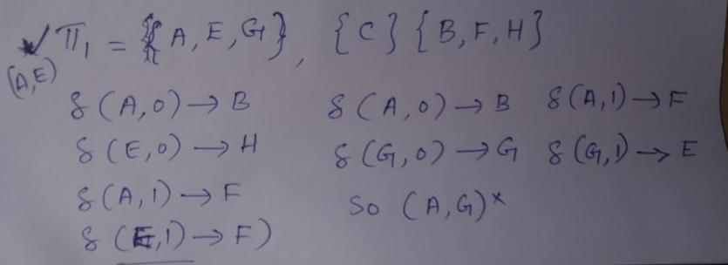

Slide 9
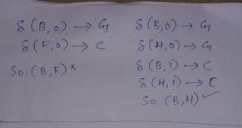

Slide 10
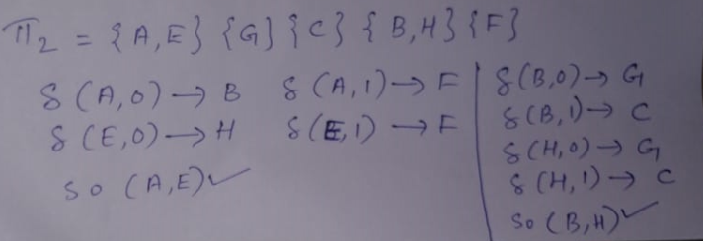

Slide 11
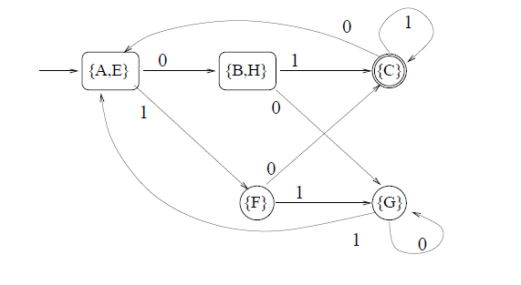
Final Answer

Slide 12
Regular expression
Representation of regular language
Defined over three operations
Union
Concatenation
Kleene Star- kleene closure
R=(a.b), L={ab}
R=(a+b), L={ a, b}
R=(a)* , L={ e, a, aa, aaa, aaaa,………..}

Slide 13
R is a regular expression if it is:
a for some a in the alphabet ∑, standing for the language {a}
ε, standing for the language {ε}
Ø, standing for the empty language
R₁+R₂ where R₁ and R₂ are regular expressions, and + signifies union (sometimes | is used)
R₁R₂ where R₁ and R₂ are regular expressions and this signifies concatenation
R* where R is a regular expression and signifies closure
(R) where R is a regular expression, then a parenthesized R is also a regular expression

Slide 14
What is(0|1) rep? L= {0,1}
What is (0.0)* rep ? L={ e, 00, 0000, 000000,… }
What is (0|1)* represents? L={ e,1, 0, 01, 10, 00010101, ….. }
What is (0)*.0 represents? L= {0, 00,000,0000,…}
What is (0*1.(0+1))* represents? L= { e, 10,11, …}
What is (00)+ represents? Positive closure L={00,0000,………}
What is (1|00)* represents, L={e, 1,100,0011…..}

Slide 15
0*.1, L={1, 01,001,0001,…..}

